Slide 1

What happens when you type a URL in the browser and Press Enter

Slide 2
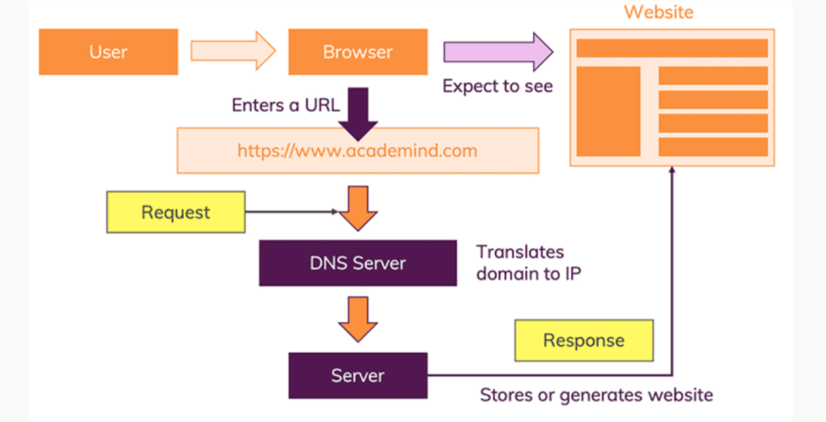
Basic Flow

Slide 3
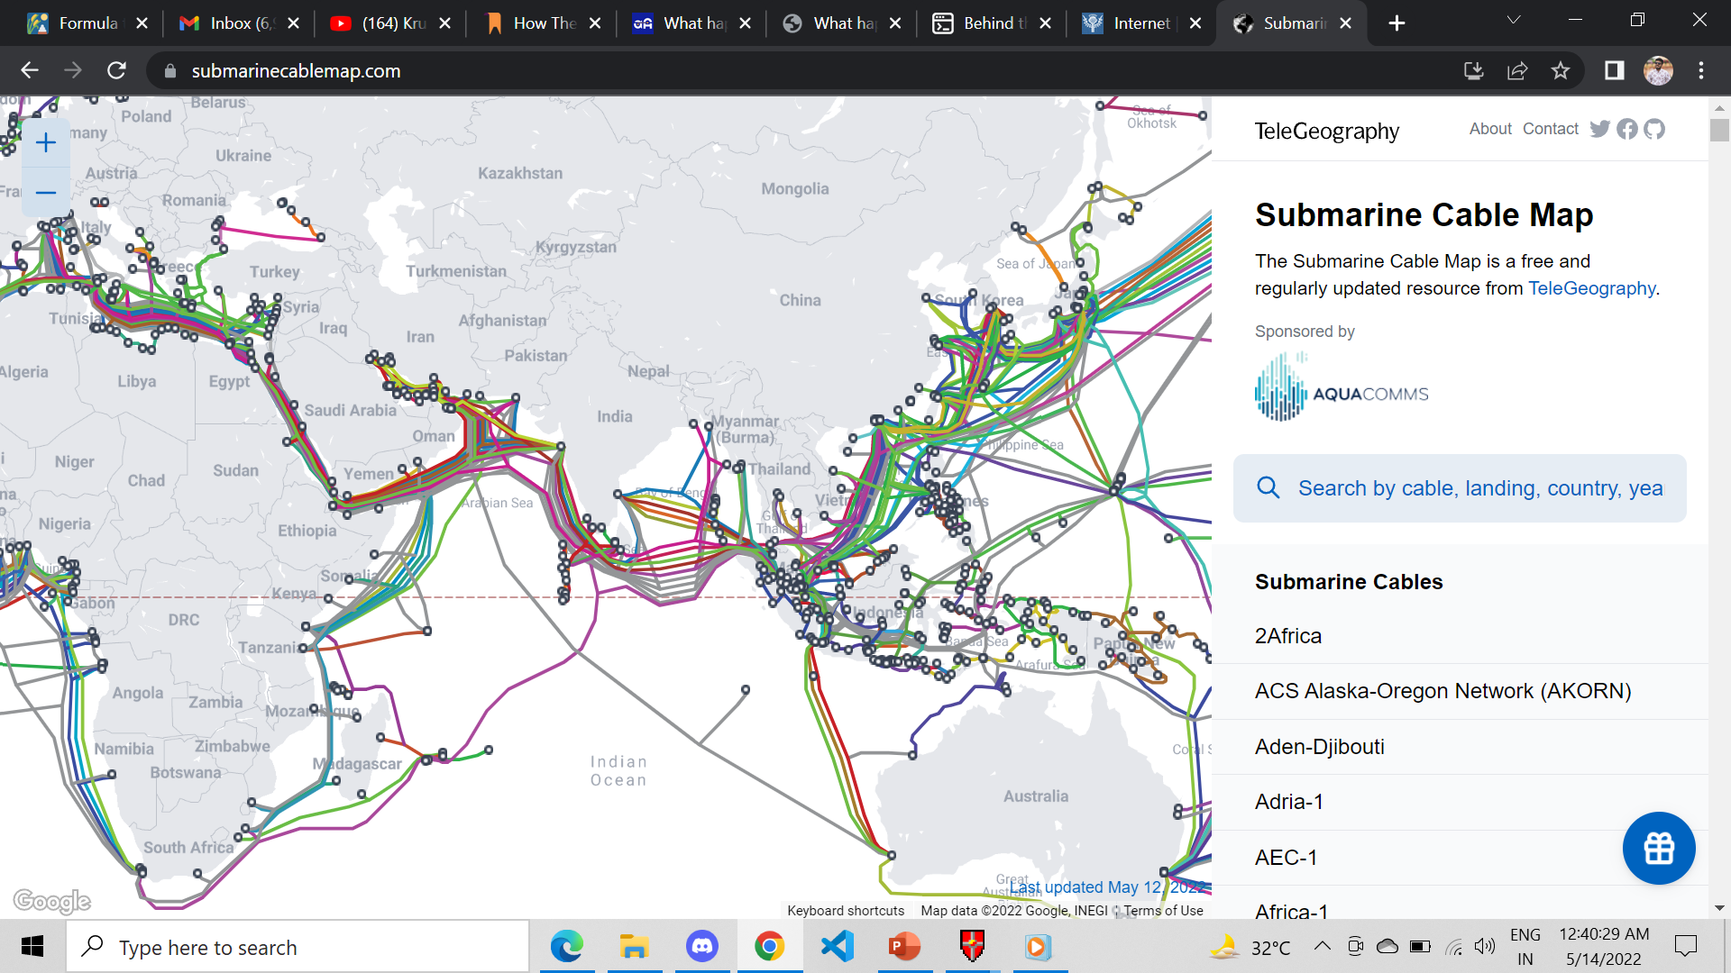
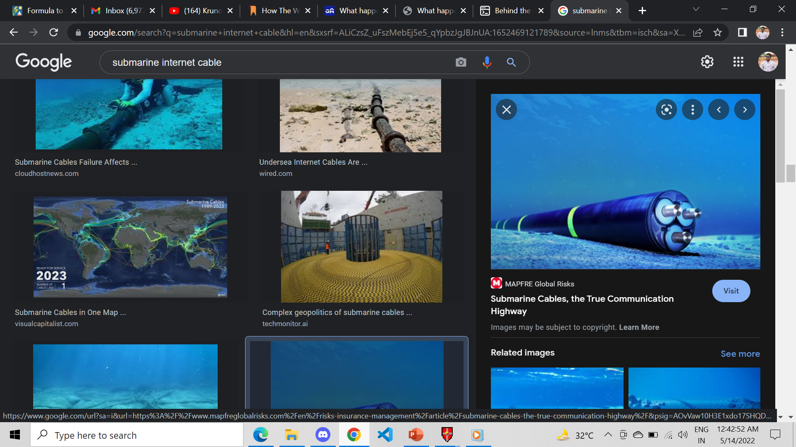
What is internet ?
The Internet is a vast network that connects computers all over the world. Through the Internet, people can share information and communicate from anywhere with an Internet connection.

Slide 4
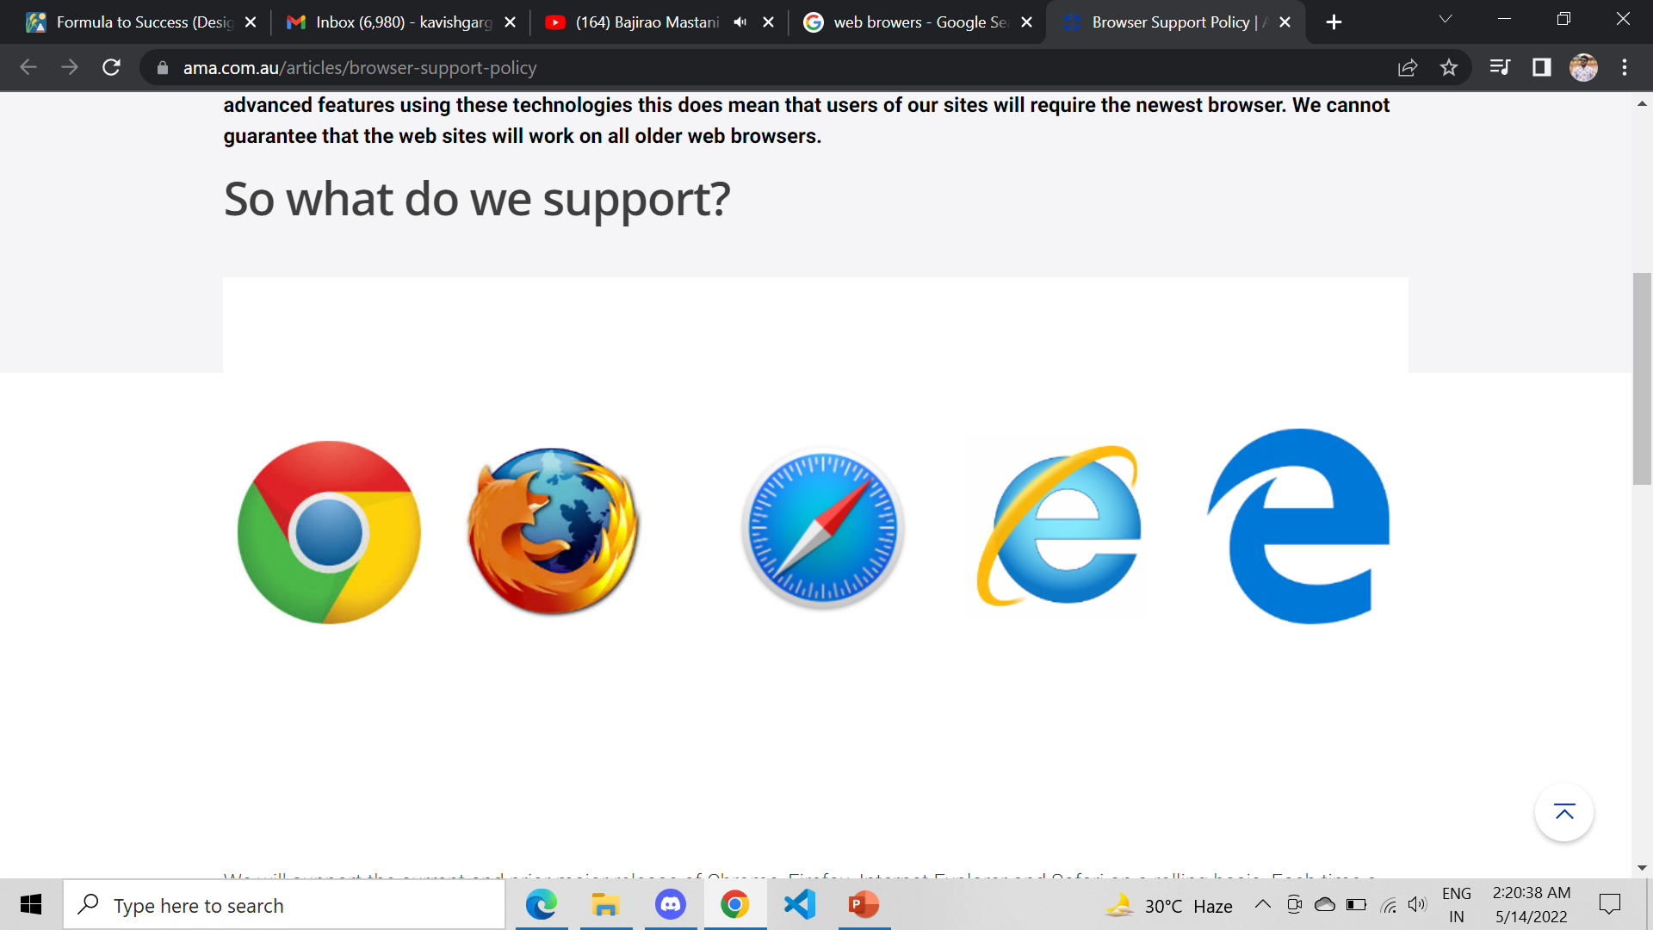
What is Web browser?
Web Browser is an application software that allows us to view and explore information on the web. User can request for any web page by just entering a URL into address bar.
Web browser can show text, audio, video, animation and more. It is the responsibility of a web browser to interpret text and commands contained in the web page.
What is Web site ?
All websites are files. A barebones website is just an HTML file, however, most websites today comprise of several inter-linked files which include Java Script and CSS.
Websites exist on powerful computers called servers. Servers are usually located somewhere remote from your computer. In order to display the website on your browser, it has to retrieve it from the server. Each server has an address through which it can be found and accessed called an IP address.

Slide 5
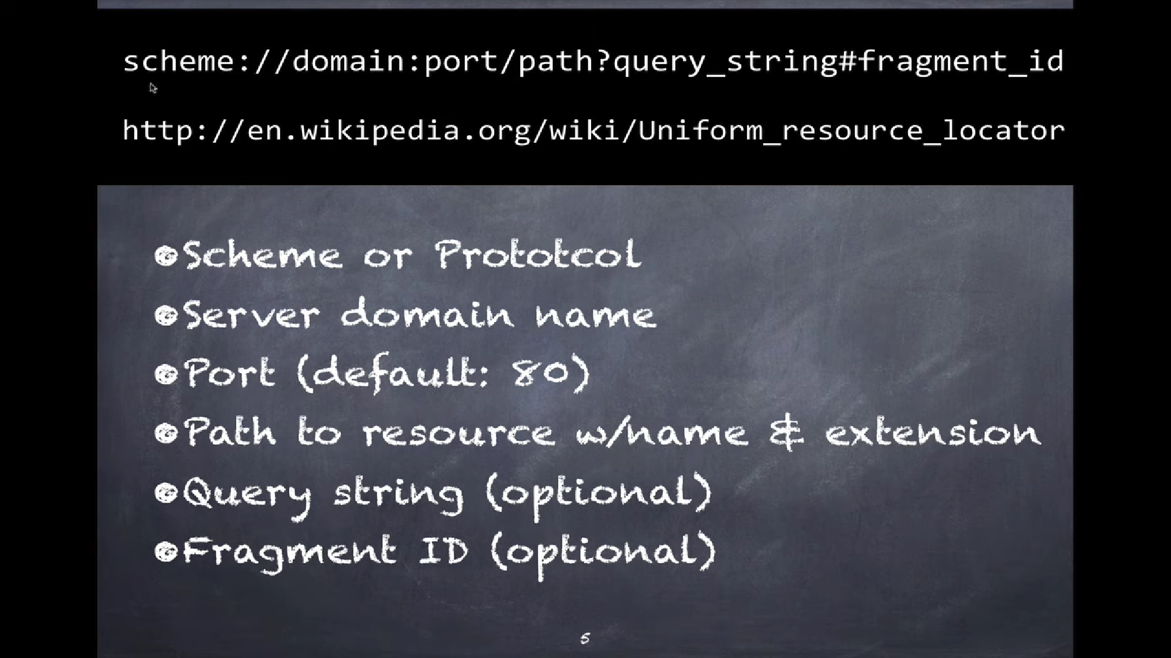
What is URL ?
A Uniform Resource Locator (URL) is used to locate a resource, in our case, the website on a server. The requested resource can be a file of any kind, for example, an MP3 file, an image, or a C++ file.

Slide 6
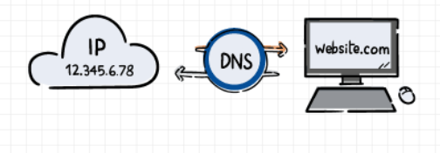
What is DNS ?
DNS(Domain Name System) is a database that maintains the name of the website (URL) and the particular IP address it links to. Every single URL on the internet has a unique IP address assigned to it. The IP address belongs to the computer which hosts the server of the website we are requesting to access.
To find the DNS record, the browser checks four caches.
Check Browser Cache:
Check OS Cache:
Router Cache:
ISP(Internet Service Provider) Cache:

Slide 7
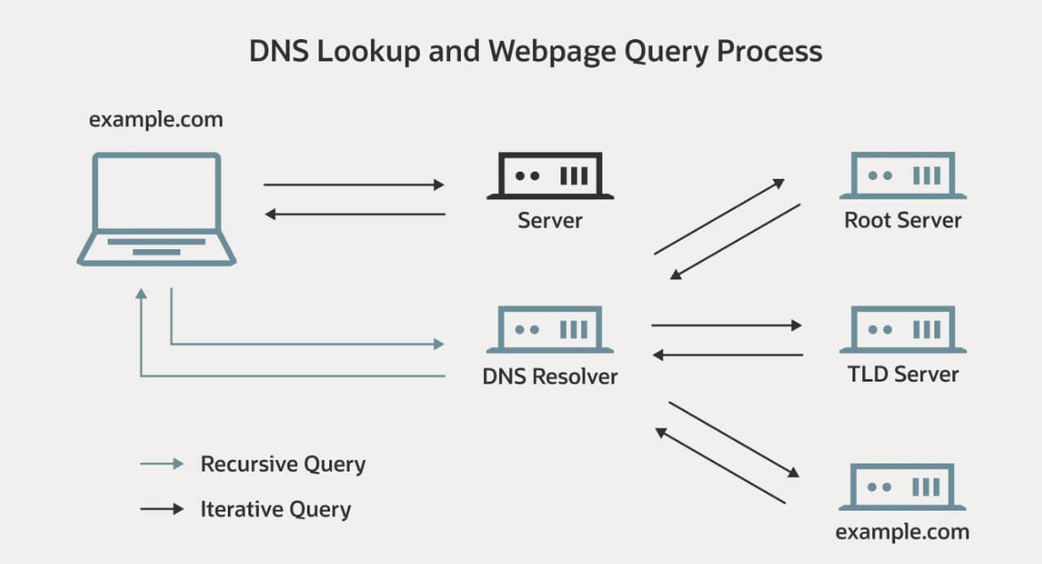
If the IP address is not found at the above three places then it is searched at the cache that ISP maintains of the DNS records. If not found here also, then ISP’s DNS recursive search is done.
In "DNS recursive search", a DNS server initiates a DNS query that communicates with several other DNS servers to find the IP address.

Slide 8
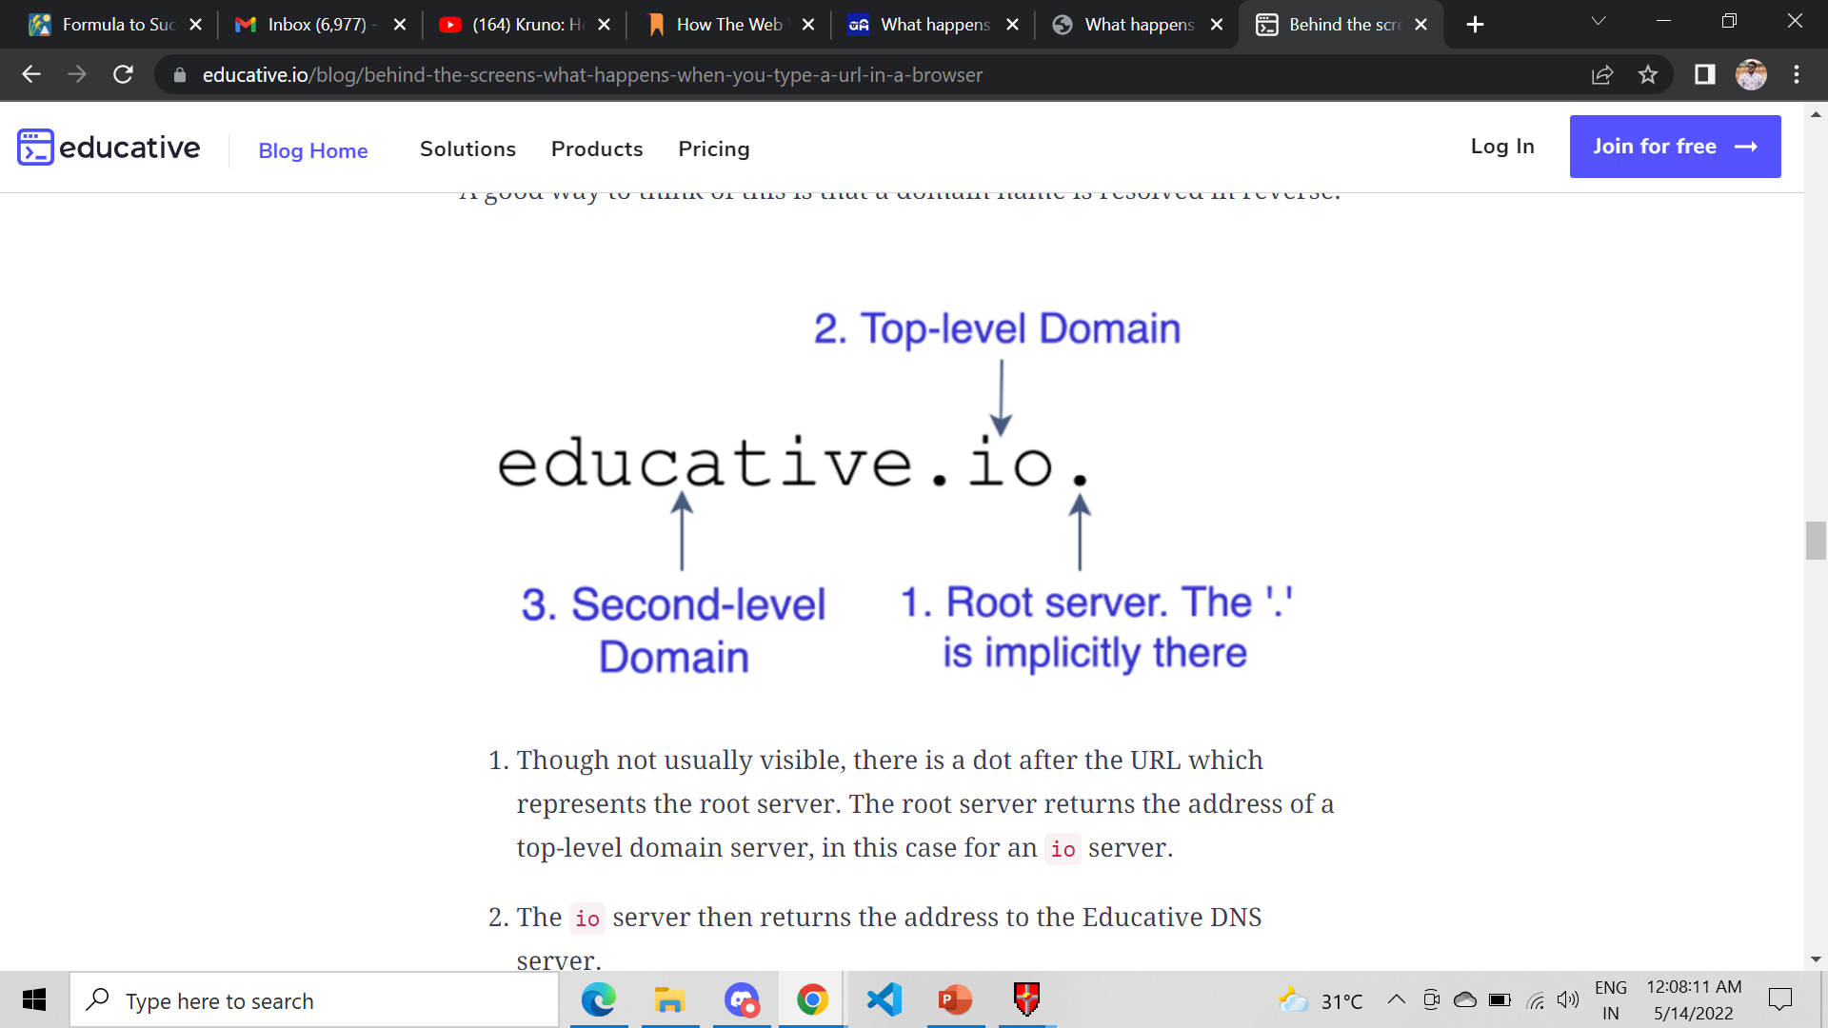
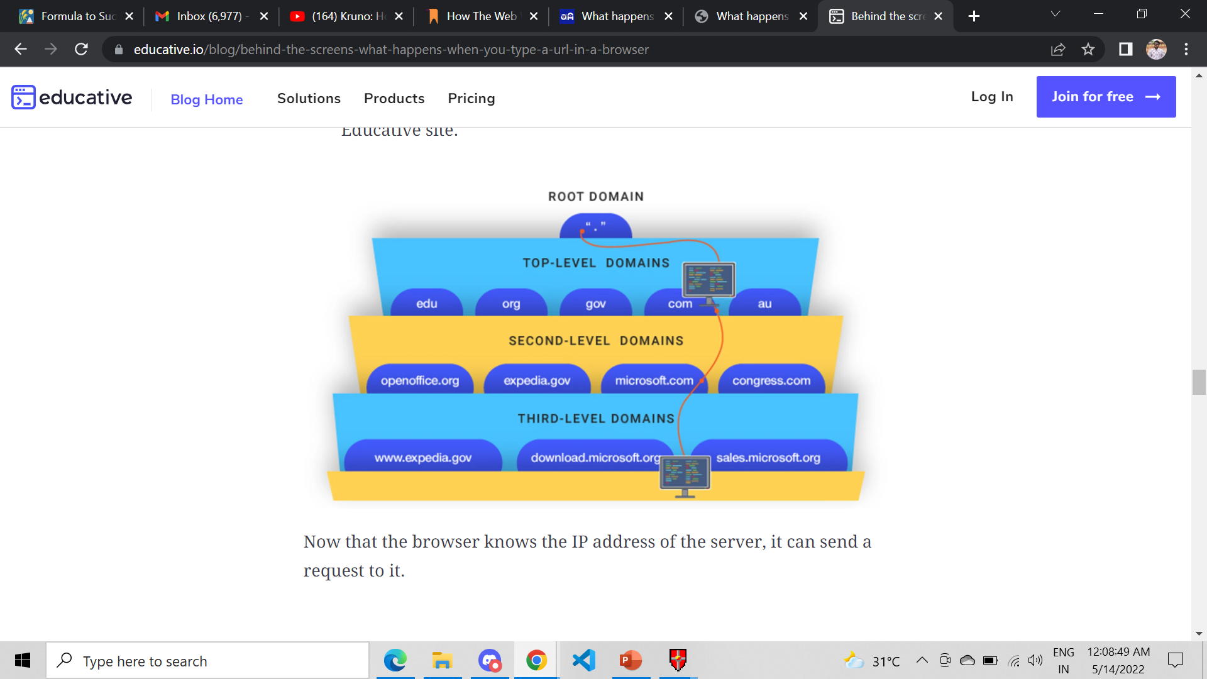

Slide 9
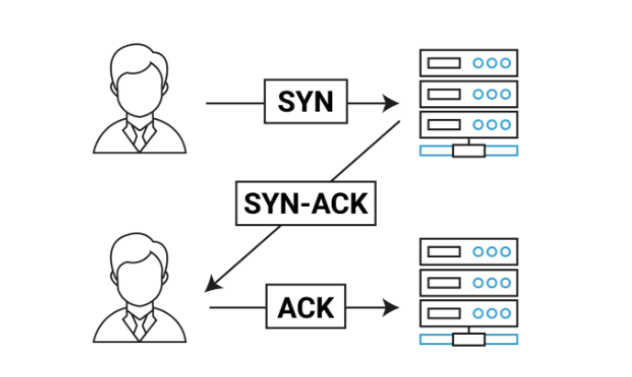
TCP Connection
When the browser receives the IP address, it will build a connection between the browser and the server using the internet protocol.
The most common protocol used is TCP protocol. The connection is established using a three-way handshake.

Slide 10
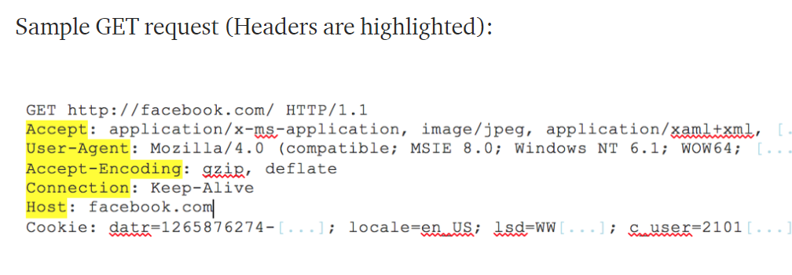
The browser sends an HTTP request to the server.
Once the TCP connection is established, it is time to start transferring data! The browser will send a GET request asking for web page. If you’re entering credentials or submitting a form, this could be a POST request.
This request will also contain additional information such as browser identification
(User-Agent header), types of requests that it will accept (Accept header), and connection headers asking it to keep the TCP connection alive for additional requests. It will also pass information taken from cookies the browser has in store for this domain.

Slide 11
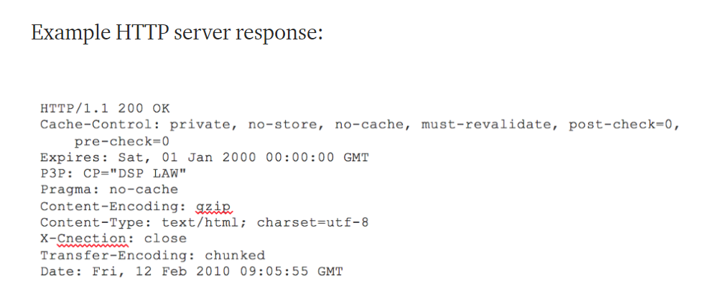
The server handles the request and sends back a response.
The server contains a webserver (i.e., Apache, IIS) that receives the request from the browser and passes it to a request handler to read and generate a response.
The request handler is a program (written in ASP.NET, PHP, Ruby, etc.) that reads the request, its’ headers, and cookies to check what is being requested and also update the information on the server if needed.
Then it will assemble a response in a particular format (JSON, XML, HTML).

Slide 12
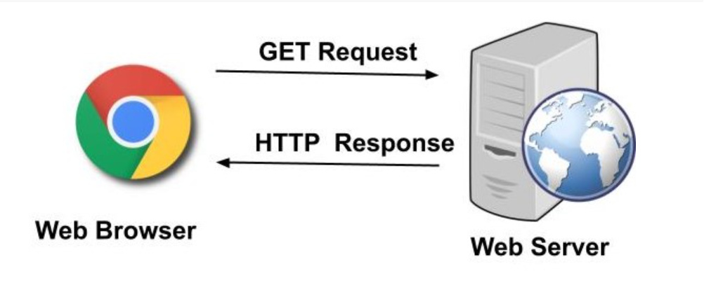
Common status codes
200 OK: the request was successful, and the result is appended with the response message.
404 File Not Found: the requested object doesn’t exist on the server.
400 Bad Request: generic error code that indicates that the request was in a format that the server could not comprehend.
500 HTTP Internal Server Error: the request could not be completed because the server encountered some unexpected error.
505 HTTP Version Not Supported: the requested HTTP version is not supported by the server.

Slide 13
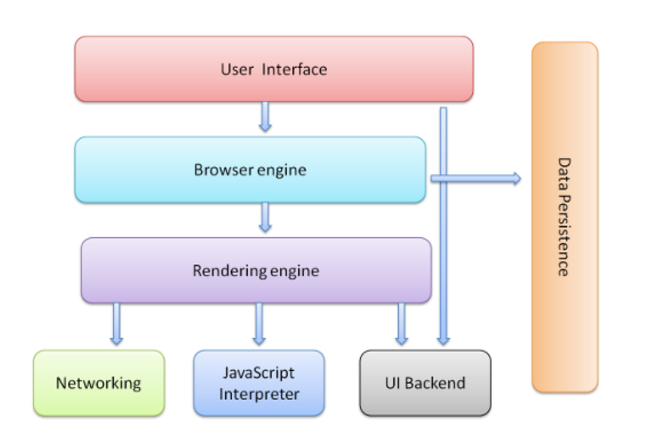
Understanding the architecture of a web browser
A web browser is a software application that enables a user to access and display web pages or other online content through its graphical user interface.
Refer to the image below to understand the key components involved in building a web browser.

Slide 14
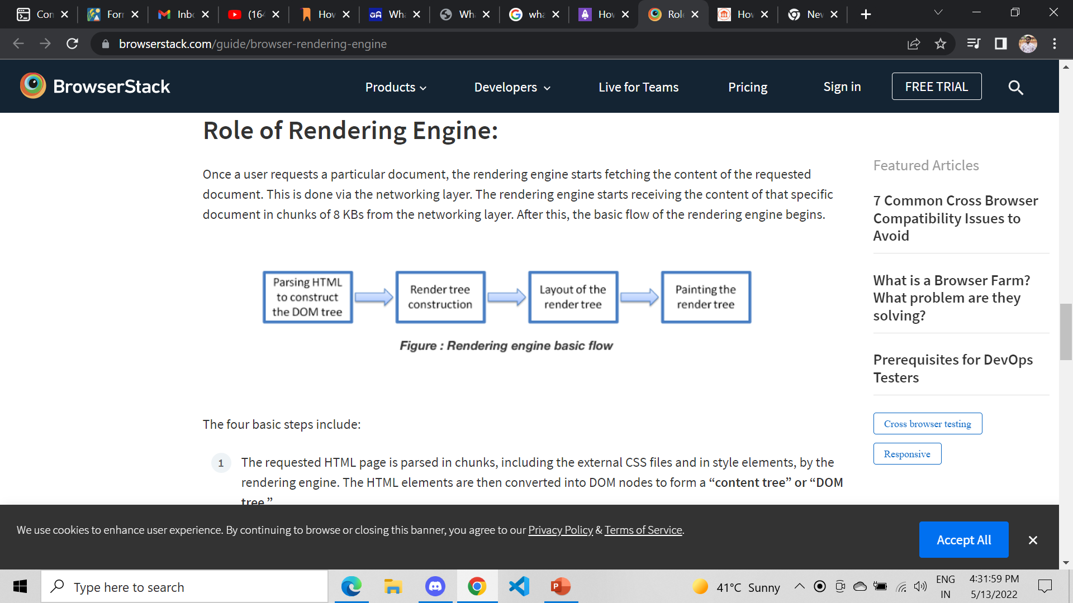
Roles of Rendering Engine
Once a user requests a particular document, the rendering engine starts fetching the content of the requested document. This is done via the networking layer.
The rendering engine starts receiving the content of that specific document in chunks of 8 KBs from the networking layer. After this, the basic flow of the rendering engine begins

Slide 15
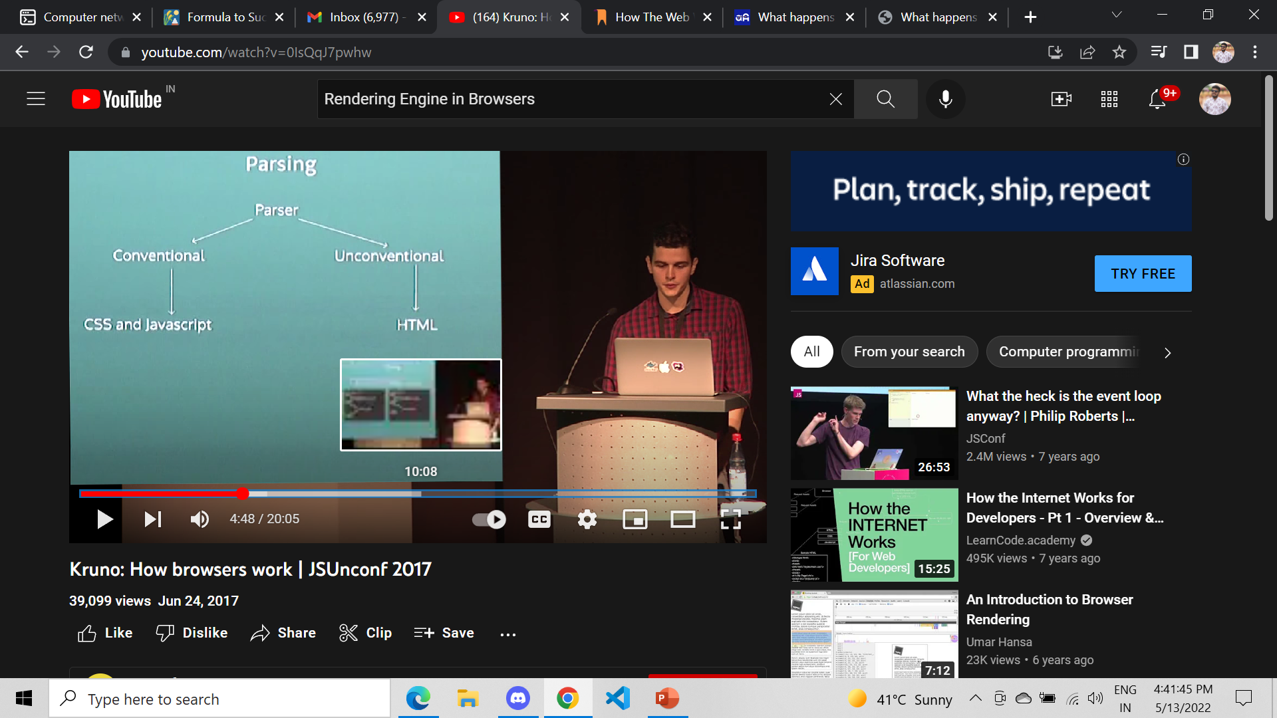
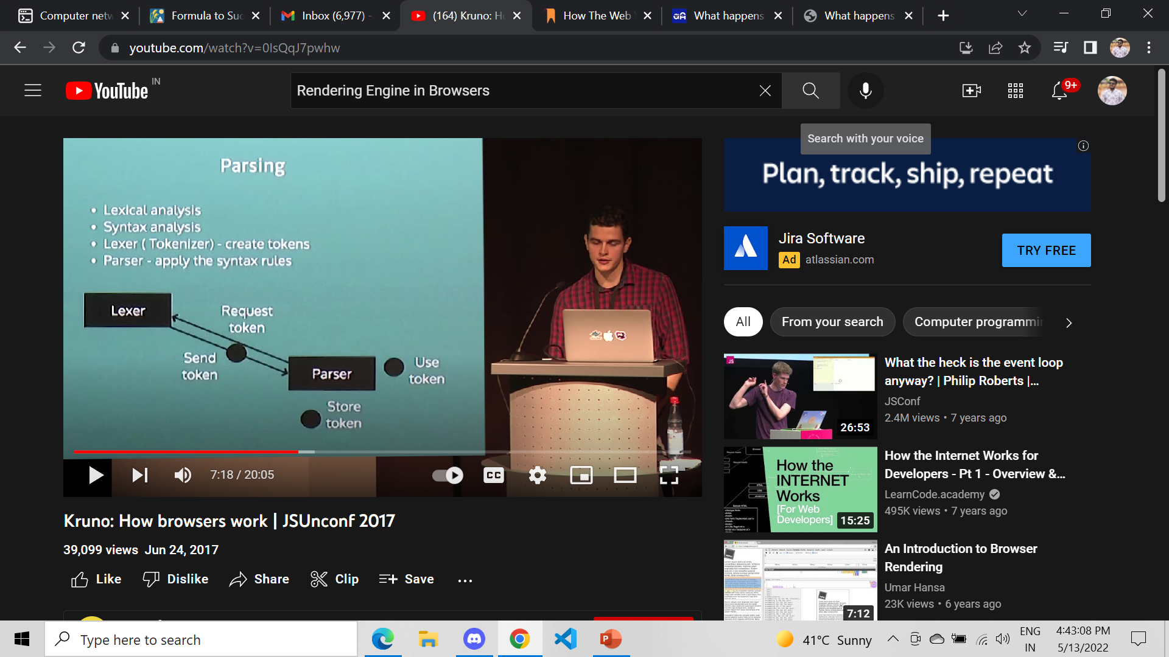
Parsing
Once the browser receives the first chunk of data, it can begin parsing the information received. Parsing is the step the browser takes to turn the data it receives over the network into the DOM and CSSOM, which is used by the renderer to paint a page to the screen.
The DOM is the internal representation of the markup for the browser.

Slide 16
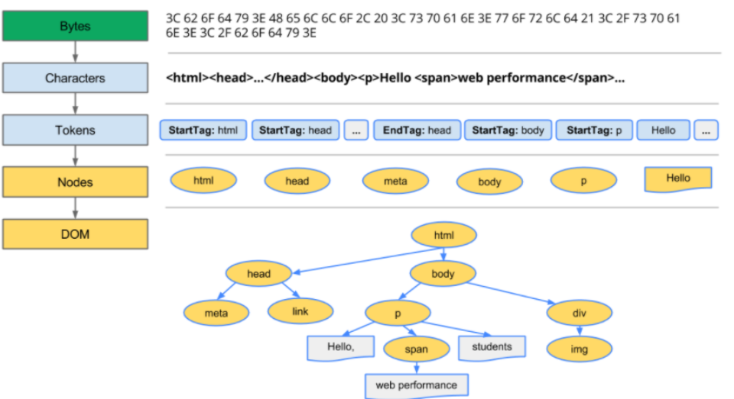
When the parser finds non-blocking resources, such as an image, the browser will request those resources and continue parsing. Parsing can continue when a CSS file is encountered, but <script> tags—particularly those Without an async or defer attribute—block rendering, and pause the parsing of HTML.
Though the browser's preload scanner hastens this process, excessive scripts can still be a significant bottleneck

Slide 17
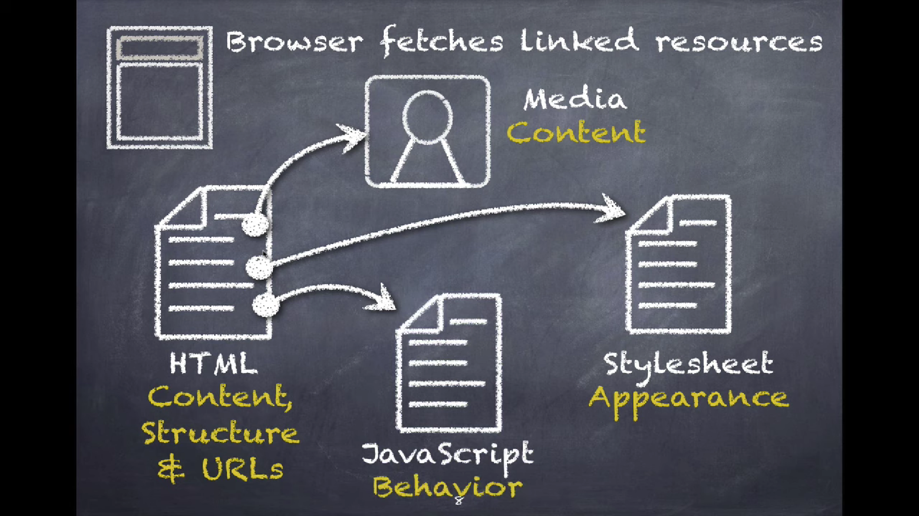
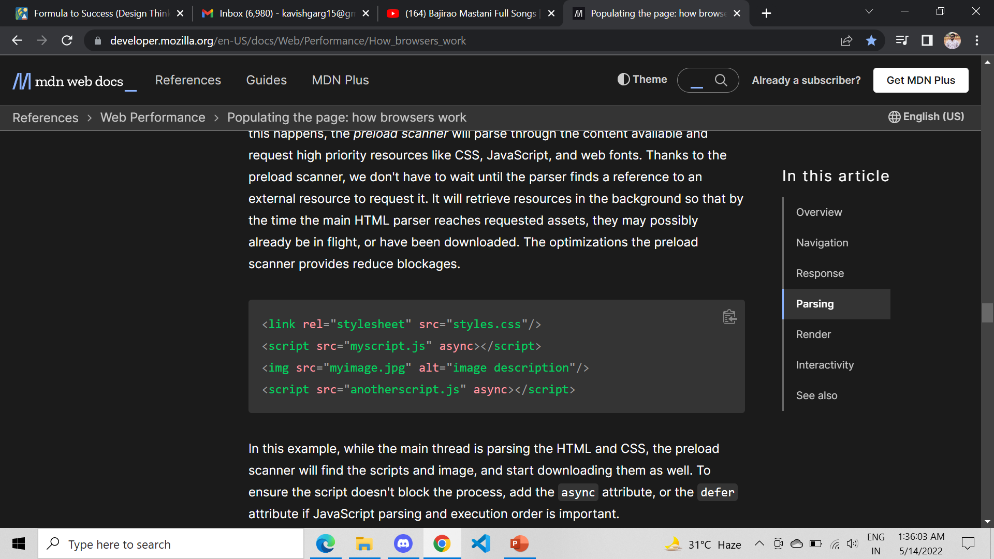
Preload Scanner
While the browser builds the DOM tree, this process occupies the main thread. As this happens, the preload scanner will parse through the content available and request high priority resources like CSS, JavaScript, and web fonts.
Thanks to the preload scanner, we don't have to wait until the parser finds a reference to an external resource to request it. It will retrieve resources in the background so that by the time the main HTML parser reaches requested assets, they may possibly already be in flight, or have been downloaded. The optimizations the preload scanner provides reduce blockages.

Slide 18
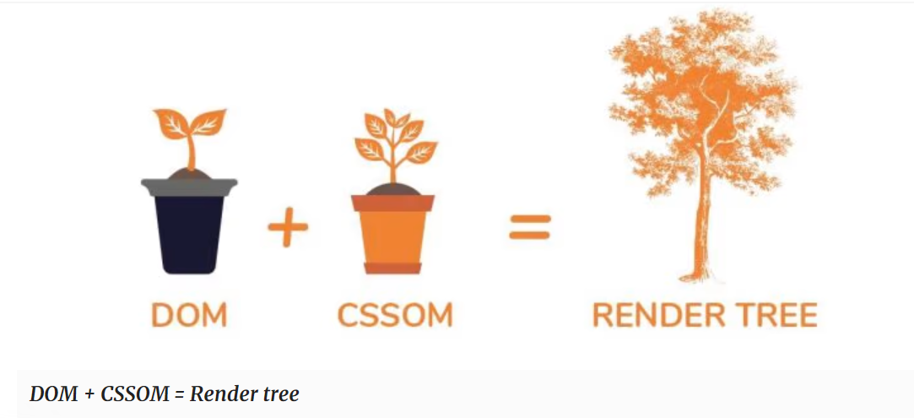
Render
Rendering steps include style, layout, paint and, in some cases, compositing.
The CSSOM and DOM trees created in the parsing step are combined into a render tree which is then used to compute the layout of every visible element, which is then painted to the screen.
In some cases, content can be promoted to their own layers and composited, improving performance by painting portions of the screen on the GPU instead of the CPU, freeing up the main thread.

Slide 19
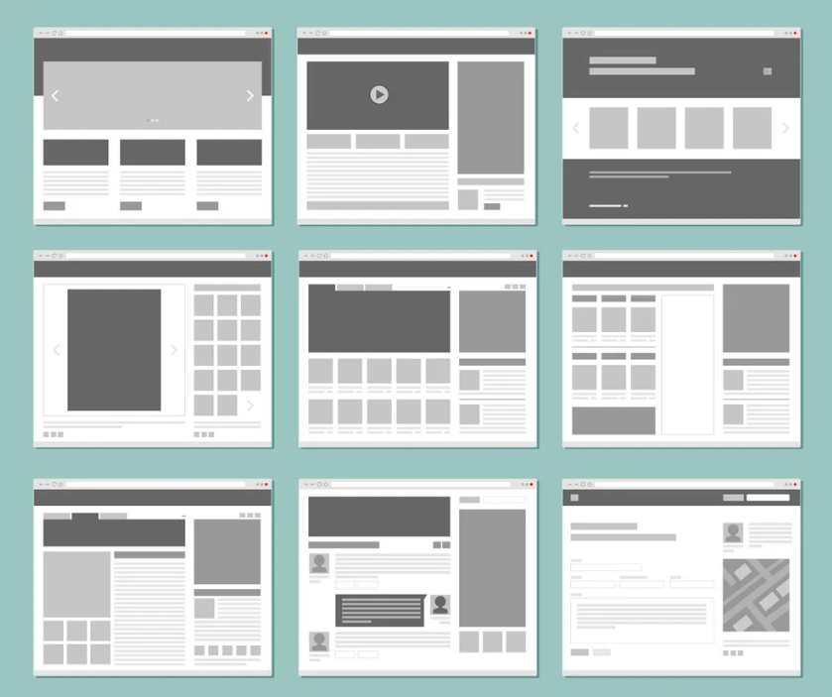
Layout
Layout is the process by which the width, height, and location of all the nodes in the render tree are determined, plus the determination of the size and position of each object on the page.
Once the render tree is built, layout commences. The render tree identified which nodes are displayed (even if invisible) along with their computed styles, but not the dimensions or location of each node.
To determine the exact size and location of each object, the browser starts at the root of the render tree and traverses it.

Slide 20

Visualization of Layout

Slide 21
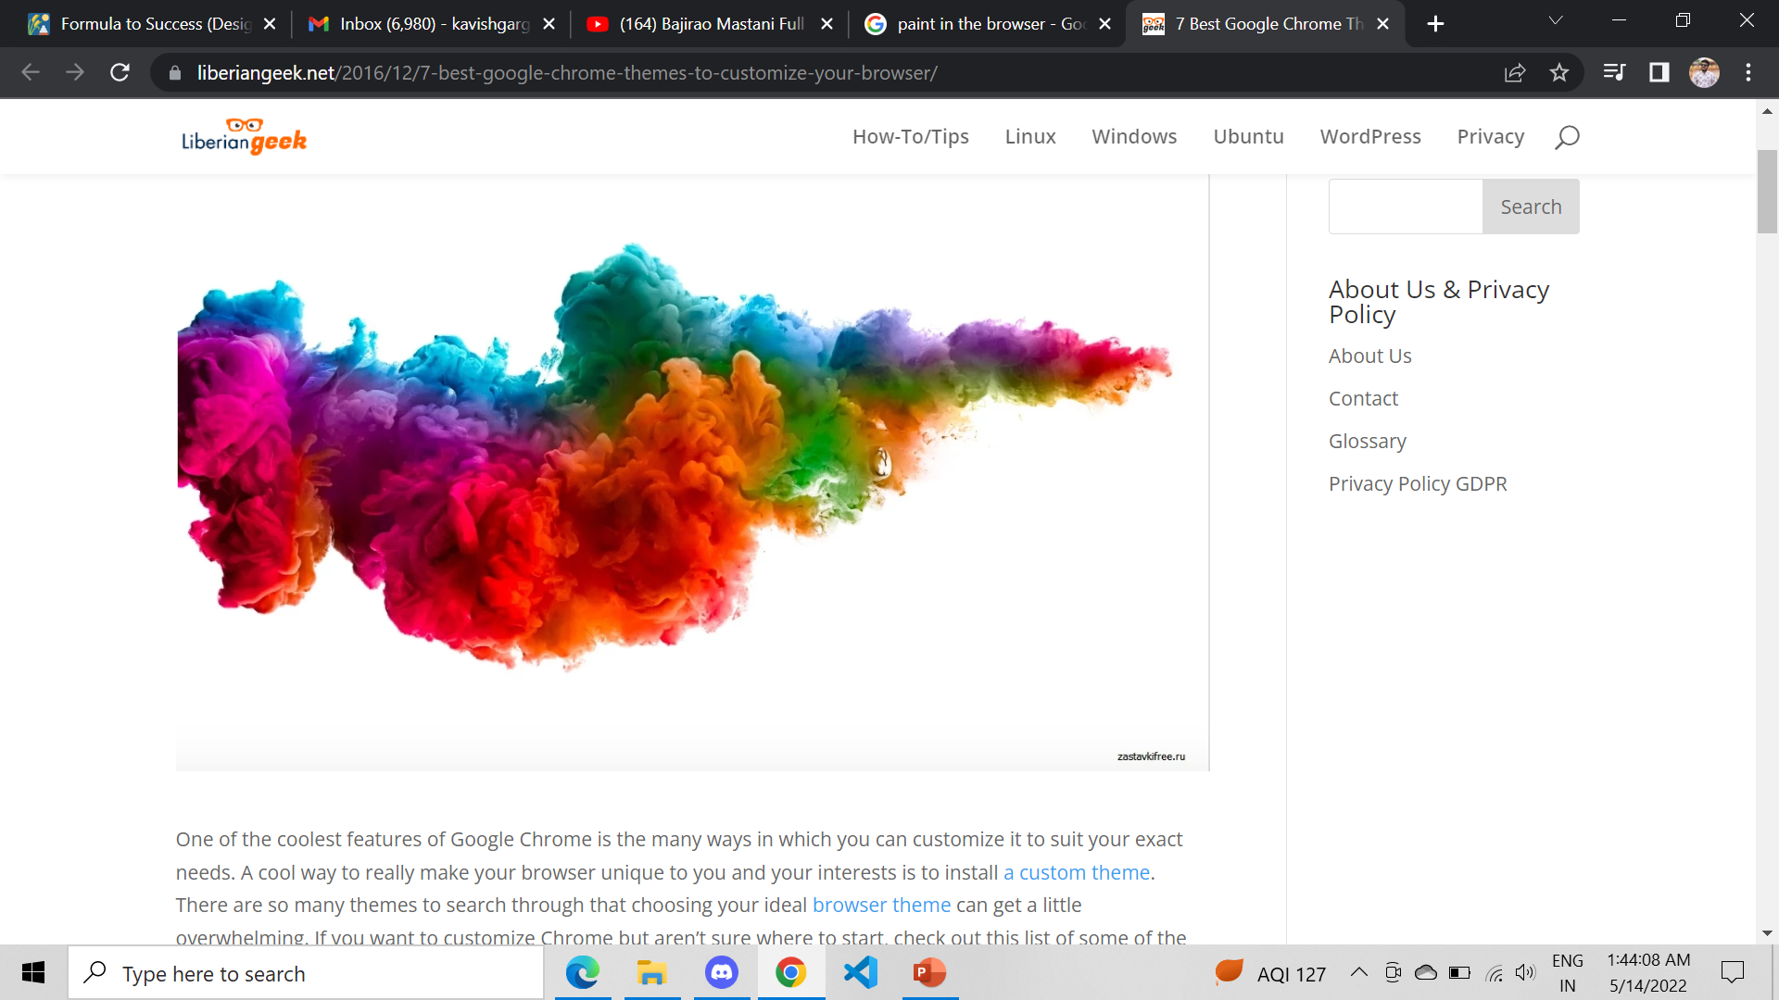
Paint
The last step in the critical rendering path is painting the individual nodes to the screen, the first occurrence of which is called the Frist meaningful paint.
In the painting or rasterization phase, the browser converts each box calculated in the layout phase to actual pixels on the screen. Painting involves drawing every visual part of an element to the screen, including text, colors, borders, shadows, and replaced elements like buttons and images. The browser needs to do this super quickly.

Slide 22
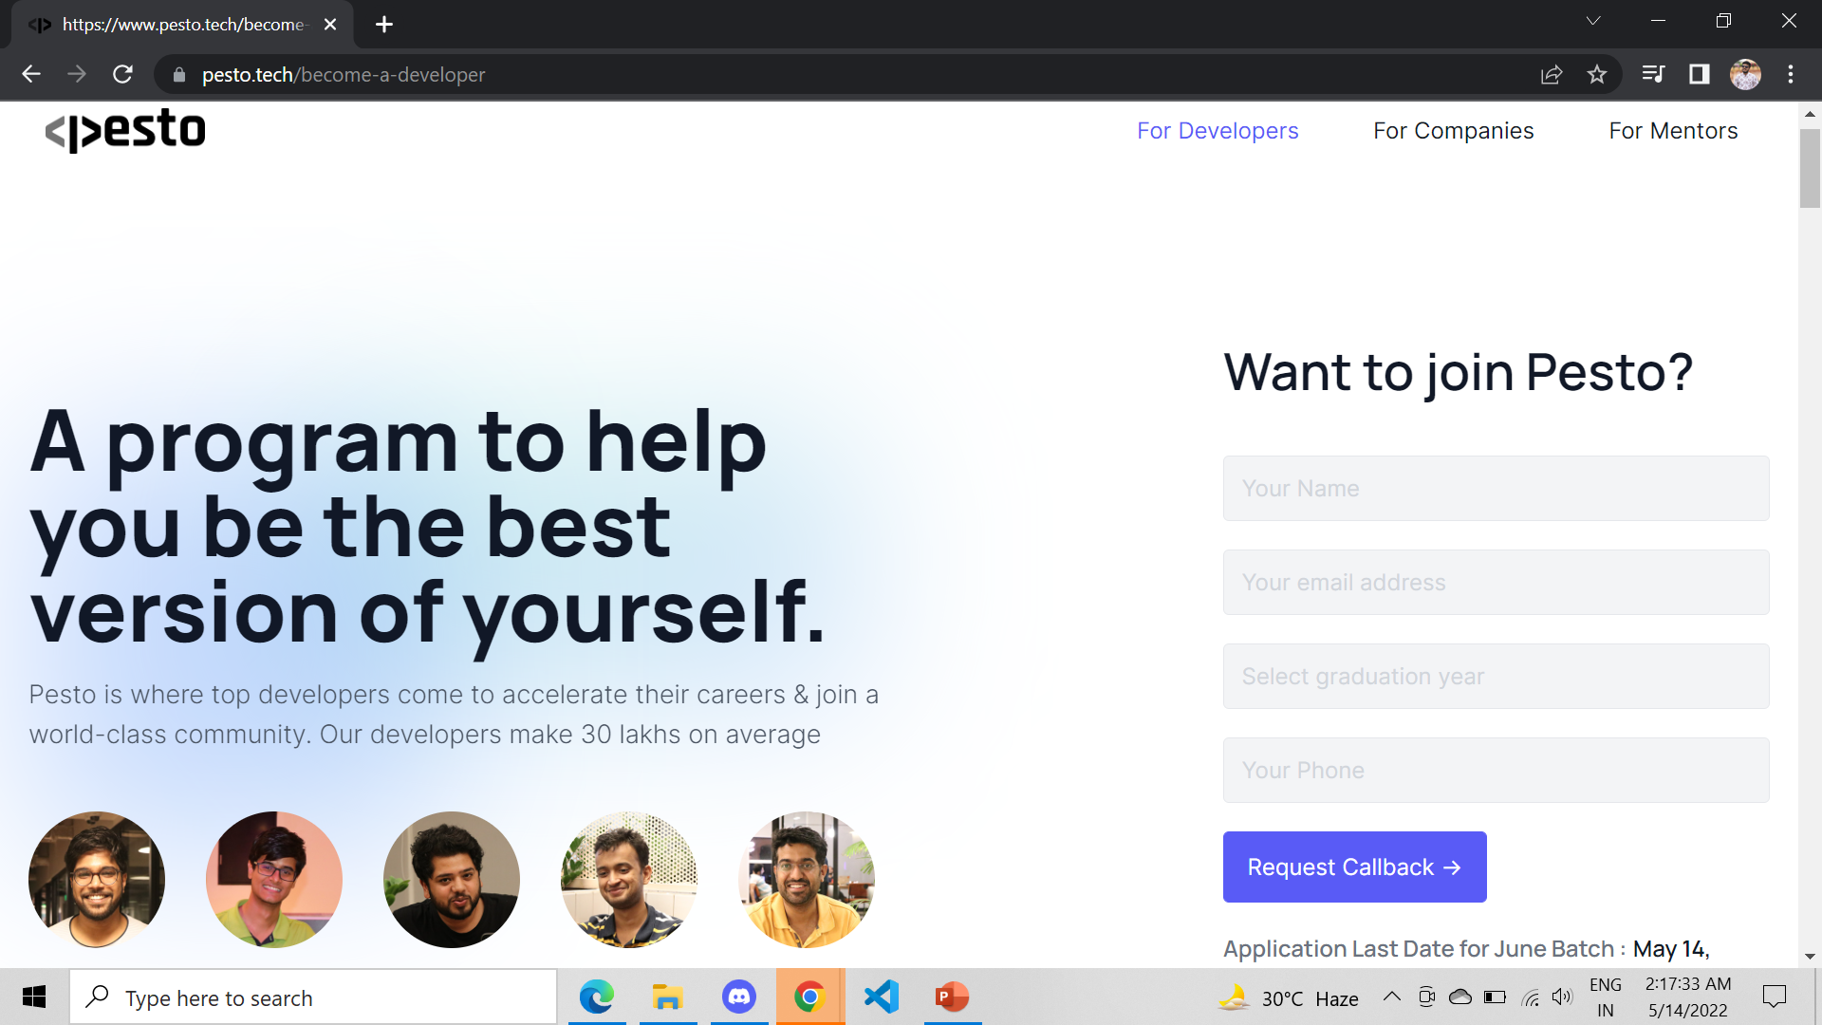
Final Out Come

Slide 23
Thank You

